Slide 1
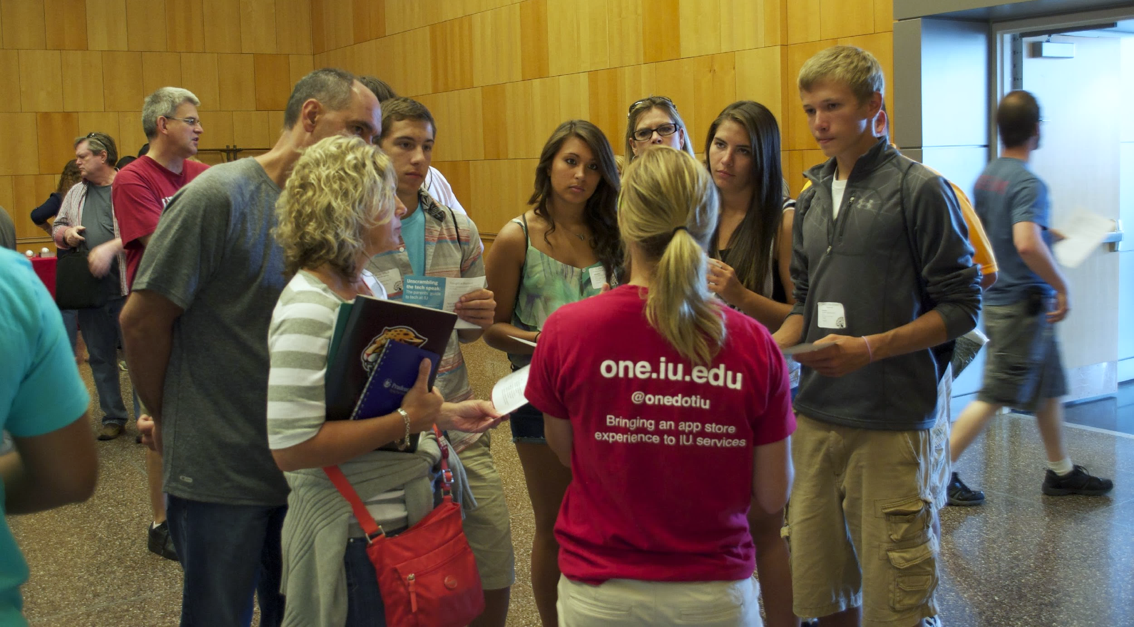


How to Engage Student (and Staff) Voice(s)
When Implementing New Technology
Students Engaging Students

Slide 2
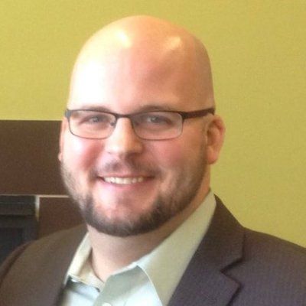
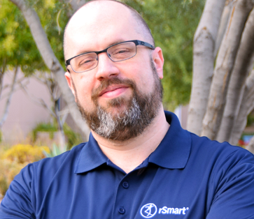
Introductions
Ryan Vallow
Lead Business Analyst - Enterprise Systems Integration
Indiana University - UITS
Todd Yates
Vice President – Enterprise Architecture
rSmart

Slide 3

Agenda
How students engage with all campus services in a single location
How frequently students engage with the campus portal
Which devices students use to engage campus services
What features students prefer
How simple it is to implement a new, modern portal replacement

Slide 4
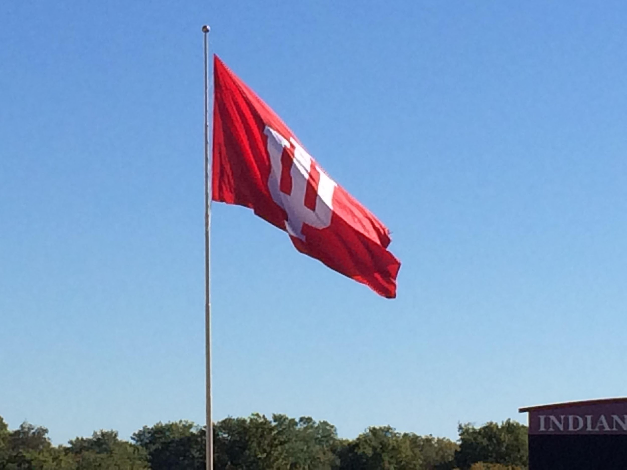
IU Fast Facts
Campuses:
2 core (IUB & IUPUI)
6 regional campuses
Total enrollment:
100,000+ students
Faculty & Staff:
24,000+

Slide 5
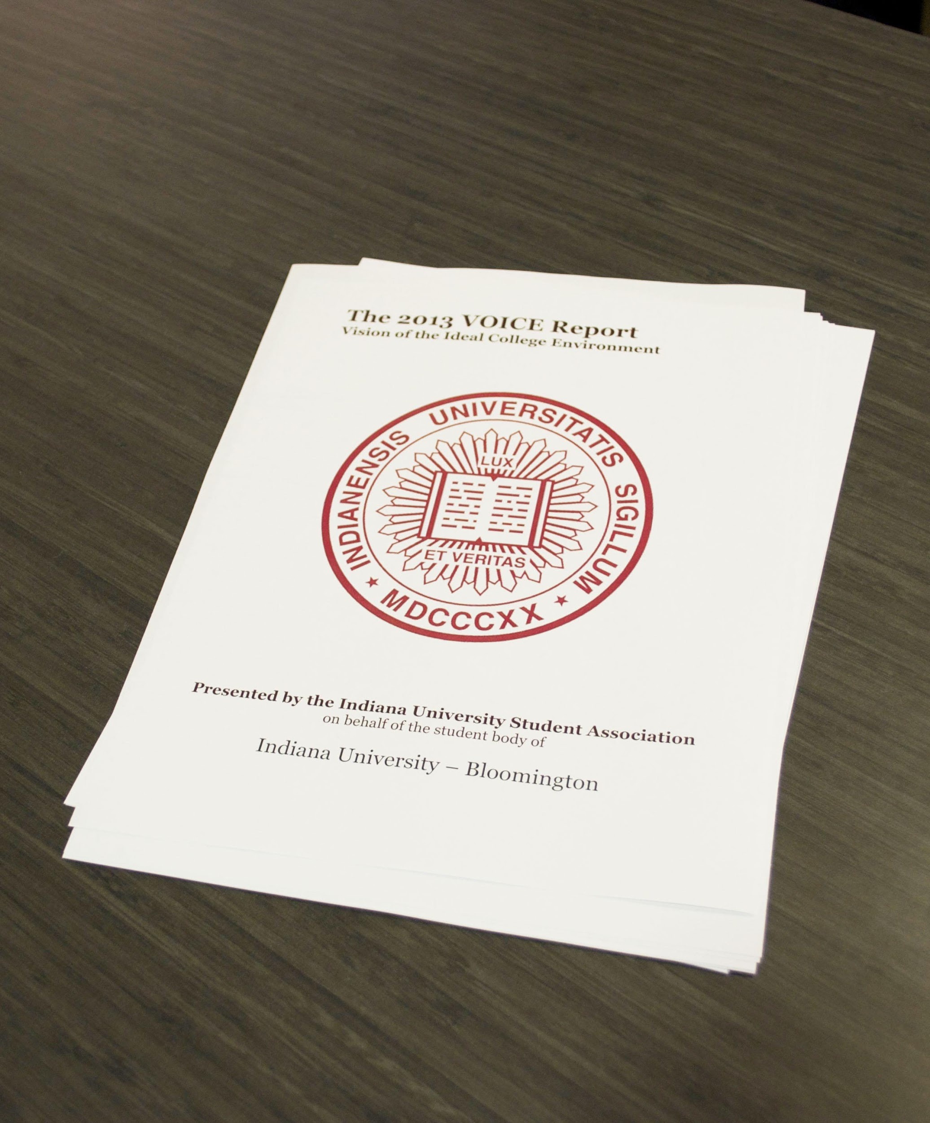
Student VOICE Report
Top Technology Recommendation:
Create an effective awareness strategy to inform students of the technological resources available on campus
Notes:
In 2013, the IU Student Association conducted a report called the VOICE report (Vision of the Ideal College Environment)
Technology was covered in the report along with Student LIfe and other topics.
Out of this report we learned that Yes, students were receiving emails from our Central IT department but only 10 percent “read almost all of them”, 42% read some of them, 43% said “I don’t read them”
Students stated they don’t want email, but personalized conversations.
You can see their top technology recommendation listed in the report was for us to create an effective awareness strategy to inform students of the technological resources available on campus.
Another question asked in the VOICE REPORT was How do you primarily find out about opportunities to join student organizations?
Top answer there was Word of mouth. So we knew that what they really wanted to listen to was what their peers were talking about

Slide 6

User Survey
“
UITS can do a lot. I seem to know very little of it.
“
UITS doesn’t do a good job of informing people of the services available.
“
This survey is the first time I knew that these technologies existed.
Notes:
these quotes are from the UITS User Survey student sections for 2013
http://www.iu.edu/~uitssur/
Reinforced the data from the VOICE report
Our user survey shows we are highly rated on the services people use… but that only works if they already know about them.

Slide 7
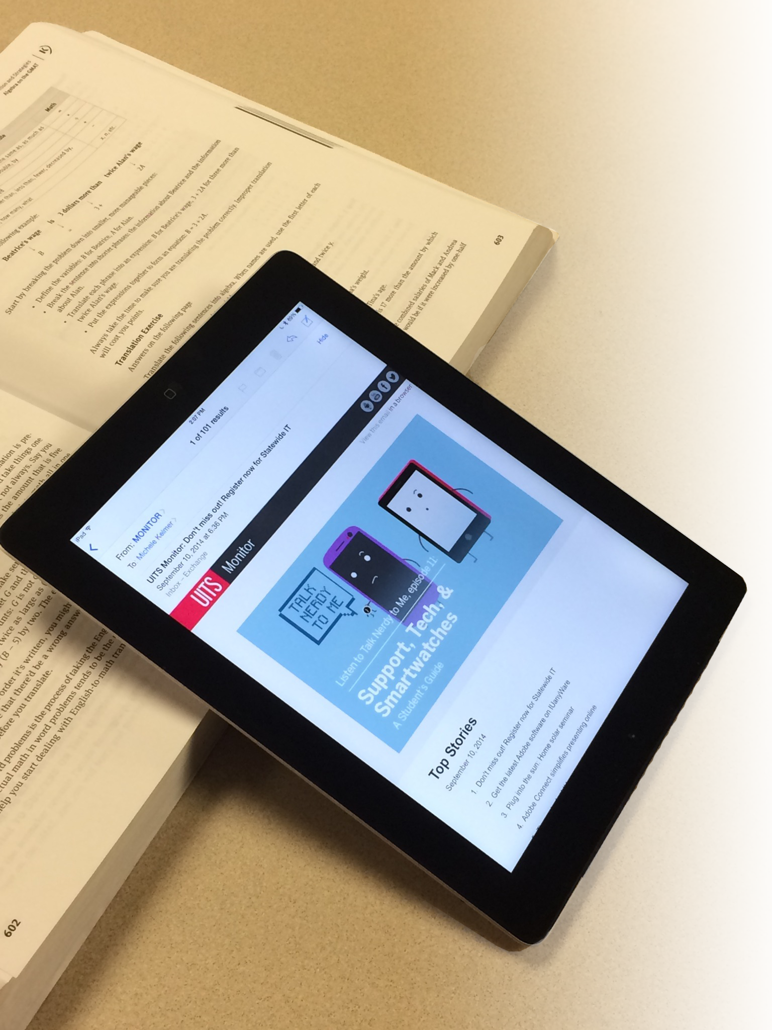

Communication
Notes:
(Image on this slide is the UITS Monitor) -
It can be difficult to gain the attention of over 100,000 students…
I’m sure we were doing what many of you have done… (show of hands?)
Back to school events
Printed materials
Web sites
E-newsletters
Sidewalk Chalk
But we found that we still weren't getting important information through to people..
Story: Student read Monitor “by mistake”
Our IT Communications Office works diligently to raise awareness of IT services among students, faculty and staff. They publish online newsletters,
Post digital signage around campus, wrap buses, host large-scale events and more. We have a great relationship with that group.

Slide 8
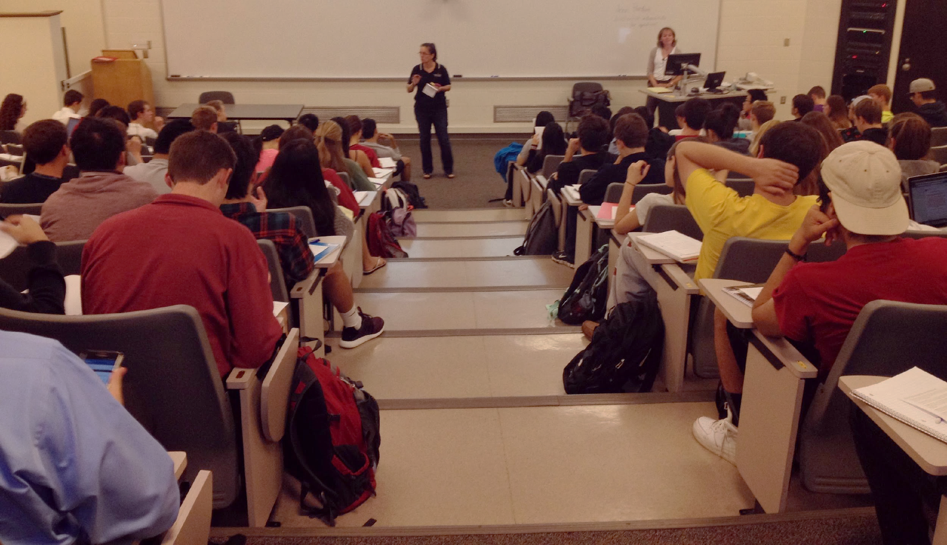
What Did We Do?
Notes:
Outreach: Utilizing student ambassadors to promote campus IT resources, technology, and tools
Networking with faculty, staff and IT unit leaders to identify opportunities
Information tables in academic buildings and high-traffic areas
Classroom presentations – varied, but we accepted all invitations
5 minutes in front of 140 students
20 minutes with 25 students
Met with student organizations
Joined special events whenever possible
Very open to feedback / criticism

Slide 9
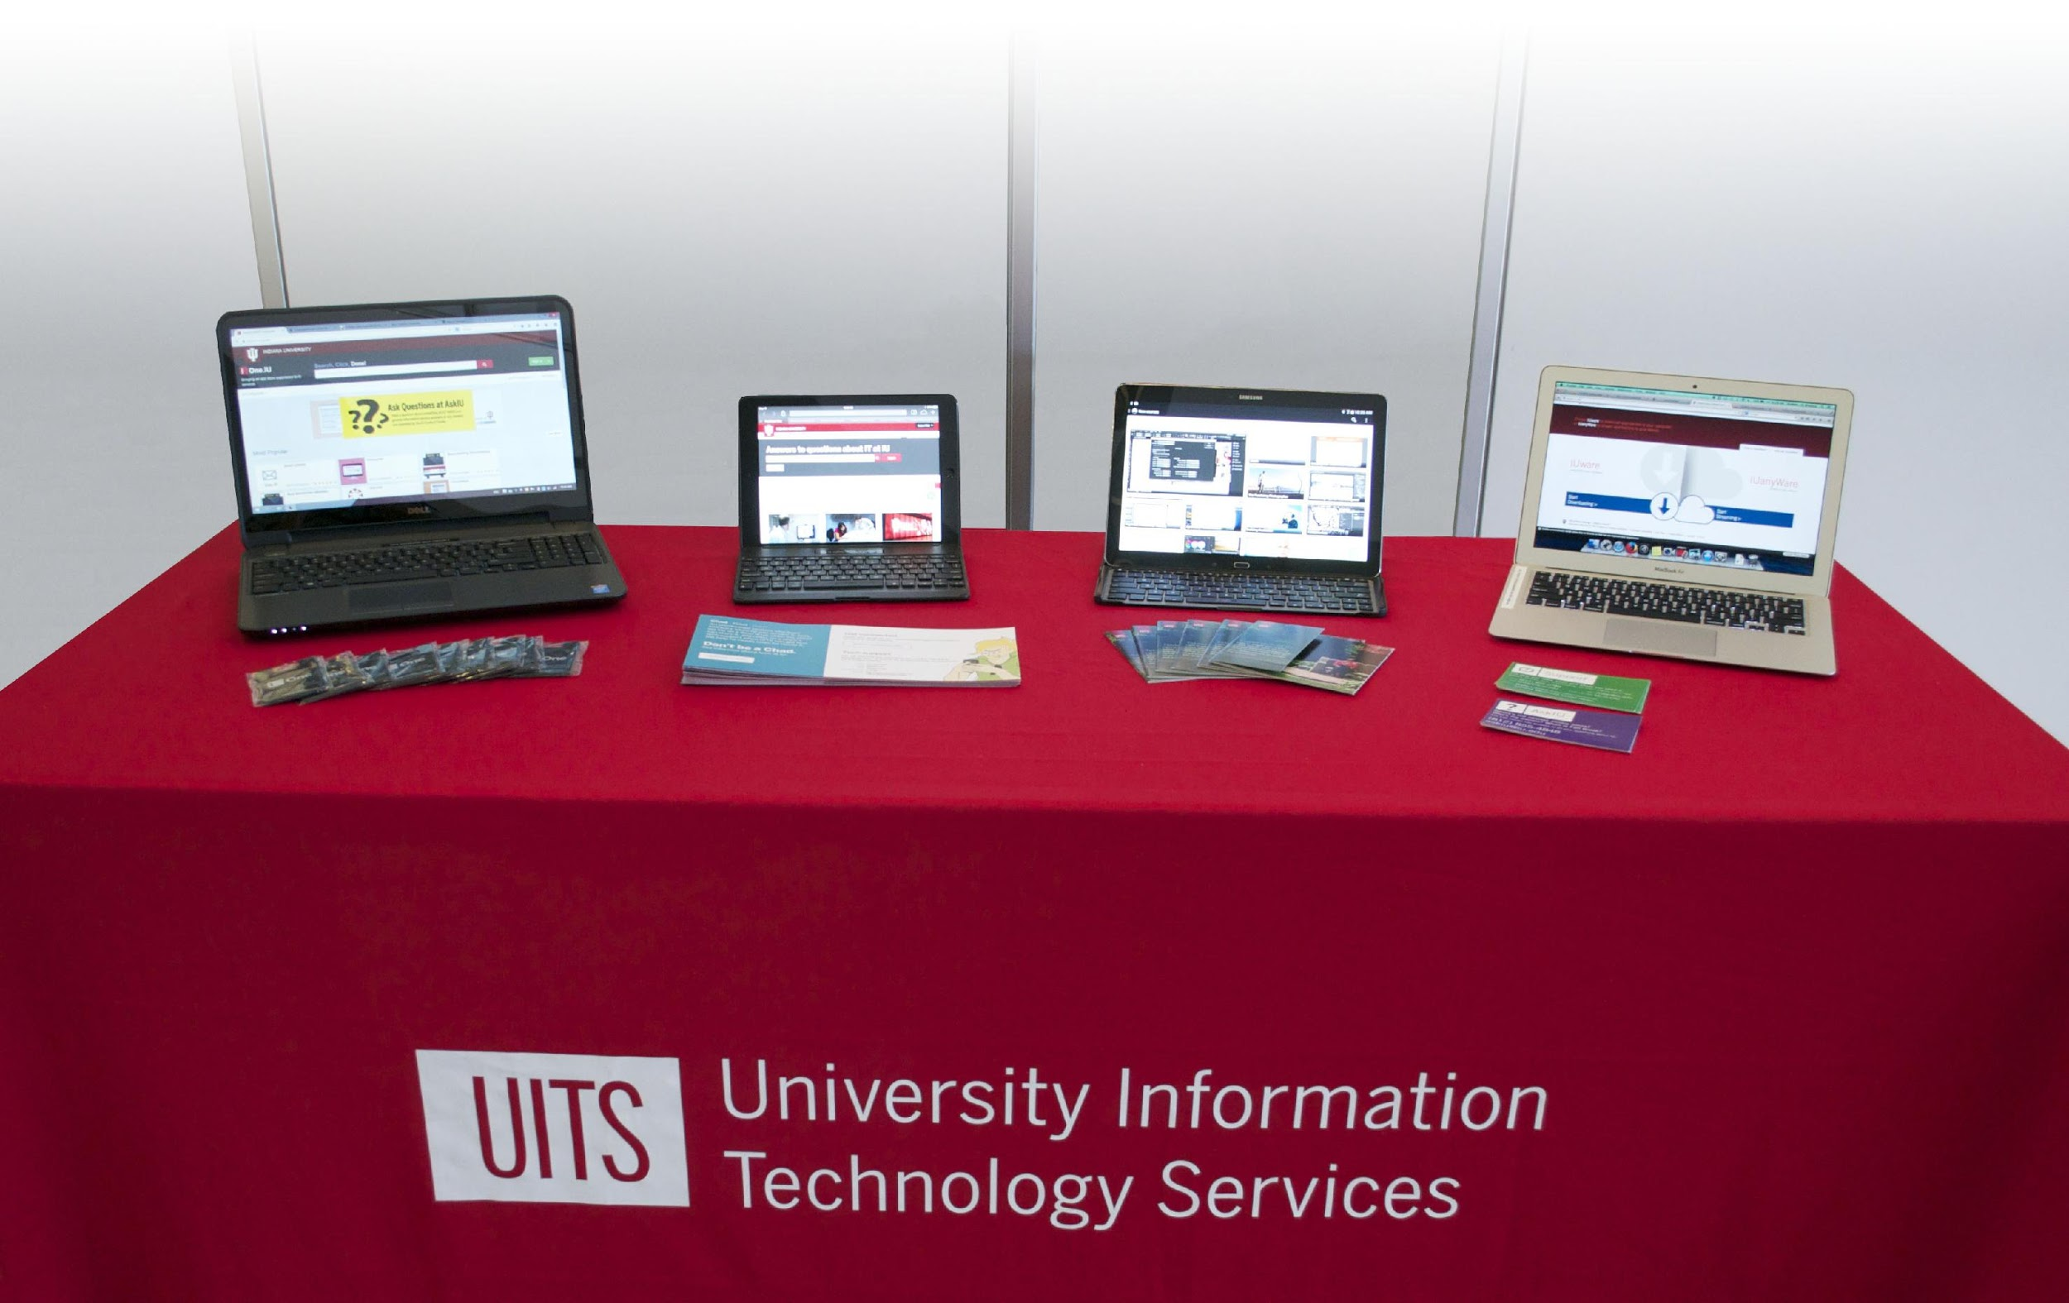
Two Simultaneous Projects
Student Outreach Pilot
One.IU
Notes:
From this feedback, two simultaneous projects emerged:
OneStart Restart project: One.IU – finding a new way for students, faculty and staff to interact with and find the services they needed at IU
Student Outreach – increase awareness, but more adoption of technology services at IU
We provide students with an abundance of technology services as part of their student technology fee… but few of them new the breadth of what was available “at no additional charge”
From the beginning, these programs have had a tremendous amount of support from our leadership.

Slide 10
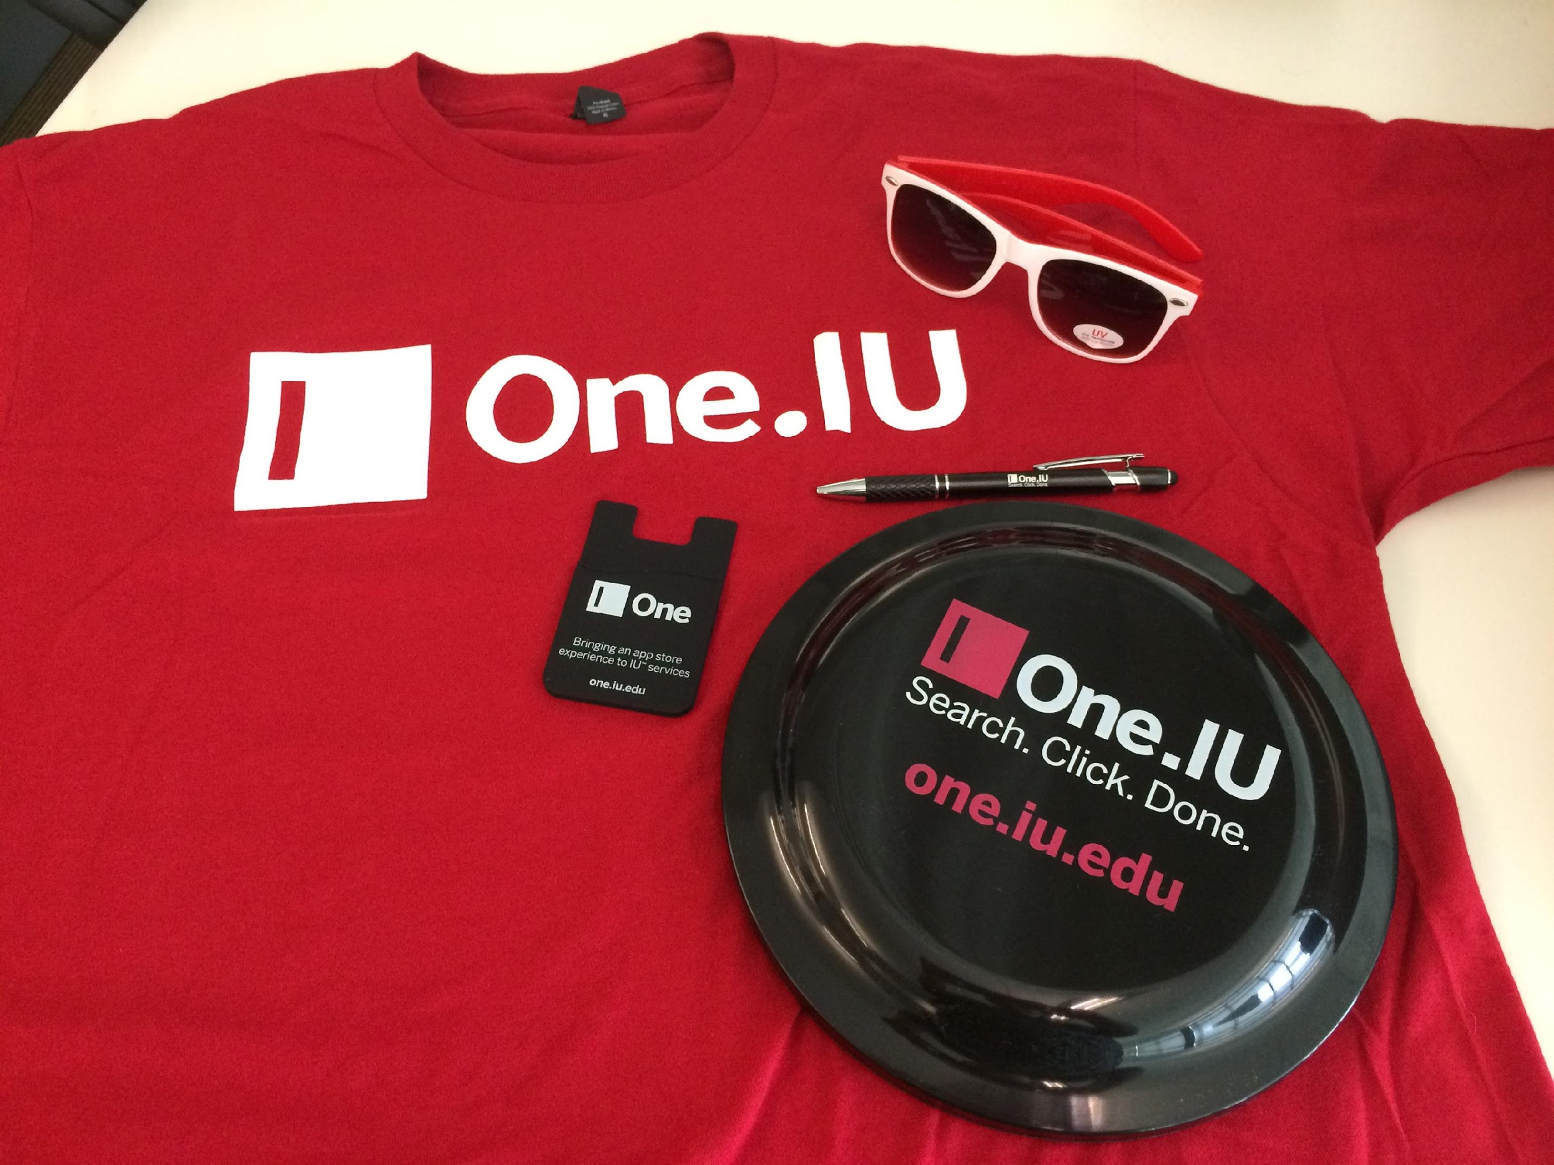
One.IU Student Team
Initial Charge:
Provide feedback
Later:
Outreach & promotion
Graphic designers
Notes:
Student feedback was key to the success of the project (we needed to create an environment where students could share their opinions openly)
One.IU: hired students to provide feedback on concepts, design, etc.
Partnering with key academic program areas to hire students as graphic designers
Identifying leaders on each campus, often members of student government or influential student organizations
Collaborating with students across eight campuses to drive future development efforts
Work with student-facing services to transition them from pointing students from our legacy system to One.IU
Team comprised of students from core and regional campuses (3 in Bloomington, one at each of the other campuses)
Met biweekly to discuss ideas
Personal feedback
Feedback gathered from peers
New ideas
Promotions (tabling, surveys, etc.)
Shared deliverables via Box
This team initially reported to the One.IU project team
Also students were hired as graphic designers to help in the process of designing the icons for the tiles and other items
We paid them well for five hours of work per week.
Giveaways –
started with just t-shirts
Smartwallets were offered to every incoming undergraduate student during summer orientation sessions in 2014
Sunglasses and frisbees have been added for this fall
Stylus pens will be used mostly for faculty and staff events

Slide 11
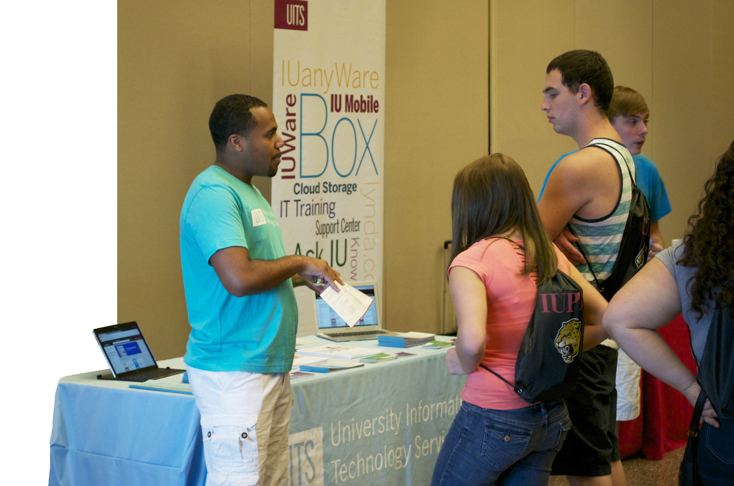
UITS Student Outreach
Pilot
Began with core campuses
Budget:
  60 hours/week/campus
  $10/hour
  Start-up equipment
First Semester:
  5,400 contacts
  101 events
Notes:
Before the pilot, we had a student organization: Student IT Ambassadors
They were volunteers
Good students, but did not have the commitment we needed to move the outreach project forward
We needed to PAY students to talk about technology on a regular schedule ☺
Details on “events”… data driven
Number of events
Number of contacts
Student Orientation
Using grassroots efforts to build awareness and collect user feedback

Slide 12
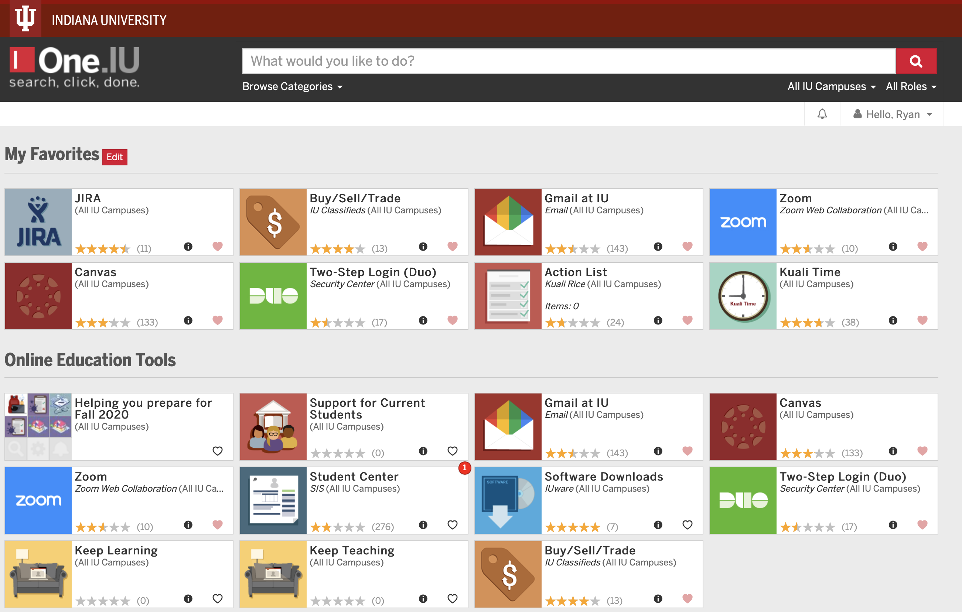
Engaging Users
SEARCH,
CLICK,
DONE.

Slide 13
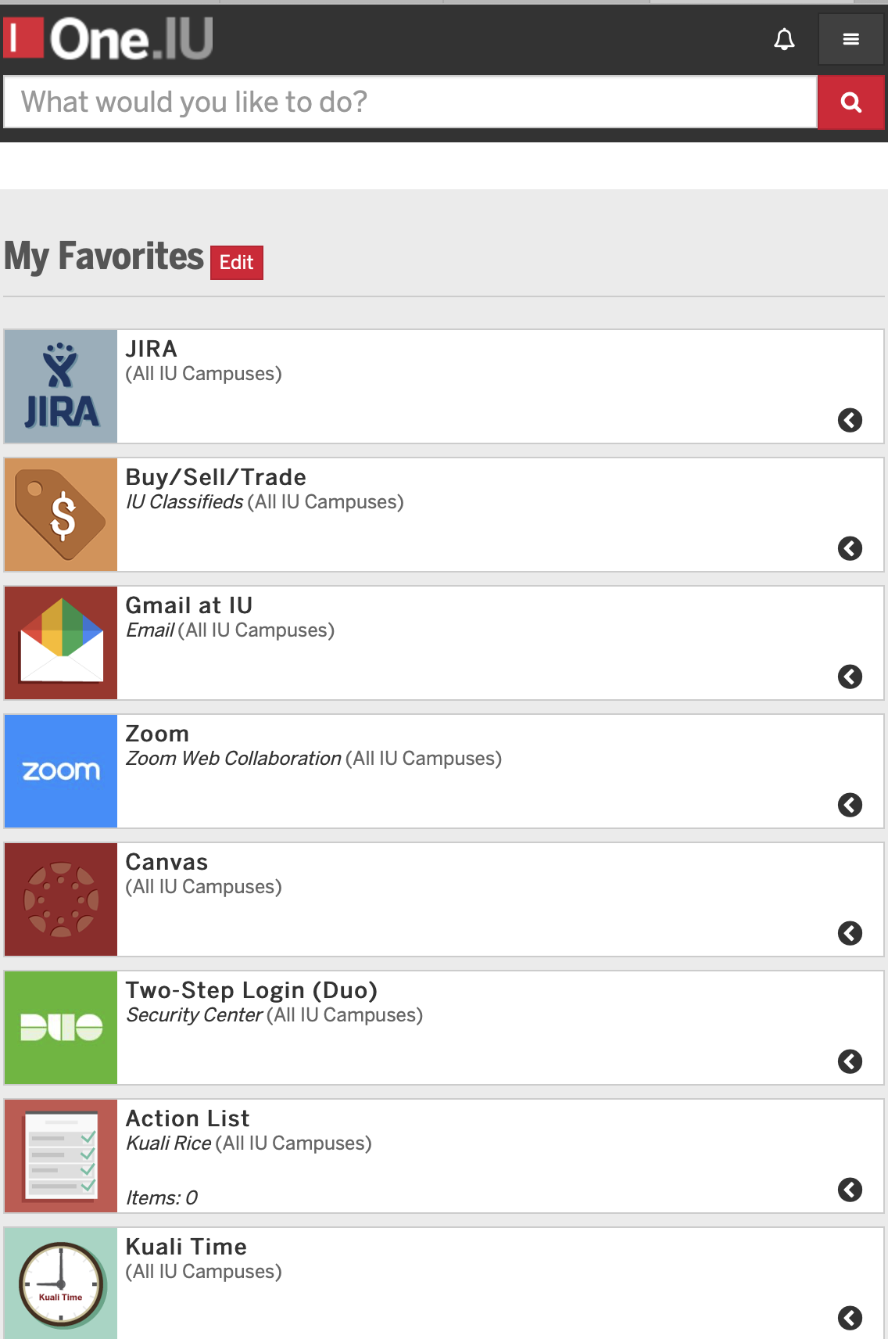
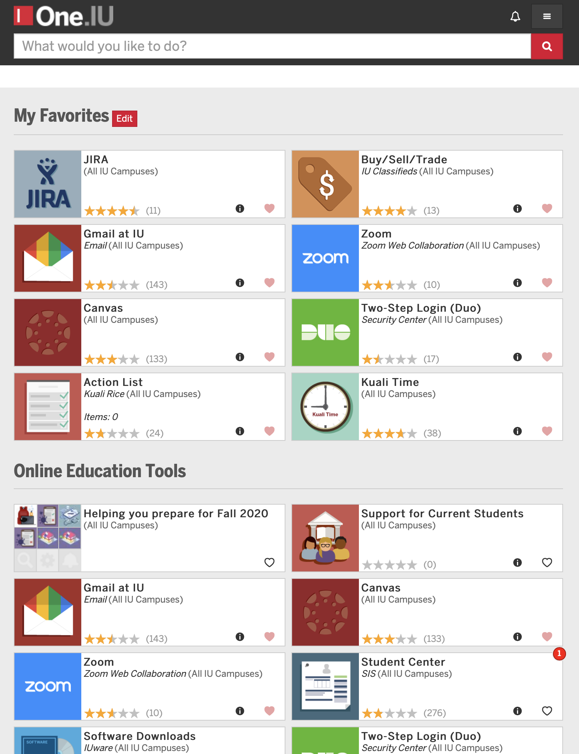
Responsive Design

Slide 14
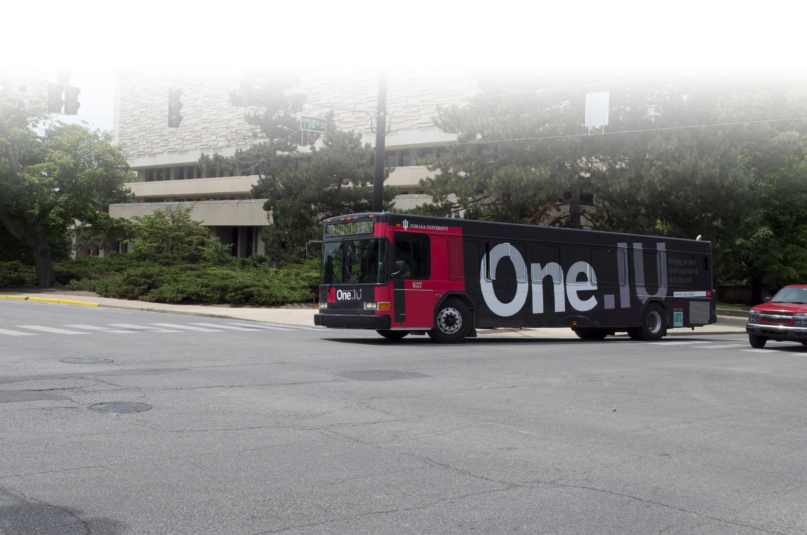

One.IU By the Numbers
1034 tasks
76 task centers
1,500+ ratings
160k+ users with one
or more favorites
Devices:
  50% desktop
  47% mobile
  3% tablet

Slide 15
DEMO

Slide 16

Student Focus Groups
Get input from your biggest user group. Your students!
Gather their thoughts early and often to stay on top of trends.
Listen to what they are saying and use that information when you are planning your roadmap.

Slide 17

Form a Team – Student Ambassadors
Engage Student Government to lead the charge
Deck them out in swag: t-shirts, hoodies, sunglasses
Count on them to spread the word to their peers
Meet with them regularly to gather important feedback
“
It is essential to get students on board and involved in promotion from the start. Students don’t want to listen to faculty/staff and would rather hear from students.
~ Katelin Corbin,
IU Student
”

Slide 18

Social Media Ideas
Create viral lists - "Our 10 favorite things about One.IU"
Promote student led videos on YouTube - “Hello Freshmen - Meet One.IU”
Put Twitter to use - create fun hashtags, contest with
prizes for retweets
Start a text marketing campaign - be the 27th person to text #OneDotIULove ##### to win
Sponsor contests across social media platforms with prizes for participation - change your profile pic to the One.IU logo to enter the drawing
Instagram for student led photos with One.IU branding

Slide 19

Students as Interns
Graphic Design students - create icons and infographic content to distribute via your social media channels
Art students - create branded sidewalk chalk drawings in strategic campus locations
Digital Arts students - create branded short films or animations
Students to assist in loading content

Slide 20

IU and rSmart Partnership
In July 2014, Indiana University partnered with rSmart to make this innovative, cloud-based solution available to all higher education institutions as OneCampus.
Notes:
Q&A period

Slide 21
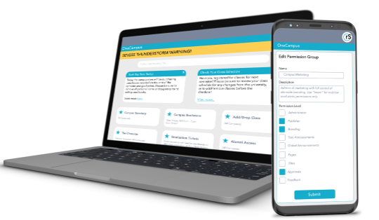

IU and rSmart Partnership
+
=

Slide 22












Partner Institutions
Notes:
Transitional slide to Lindsays portion of the presentation.
So know that we understand IU’s use of students to help drive technology adoption on campus, lets look at some other ideas that are currently being used.

Slide 23

Ryan Vallow rvallow@iu.edu
Dr. Todd Yates tyates@rsmart.com
Notes:
Q&A period

Slide 24





Connect with Us
Connect with Us
Interested in learning more about OneCampus?
OneCampus.com
425-977-2108
facebook.com/rsmart.team
twitter.com/rsmart
OneCampus.com/blog

